Slide 1

INTELLERA: A Hardware Based Accelerated Matrix MAC Processor
Team Members:
2020414 Saad Khan
2020487 Syed Zaeem Shakir
2020217 Mahnoor Maleeka
Supervisor: Dr Fahad Bin Muslim
Co-supervisor: Dr Taj Muhammad
Faculty of Computer Sciences and Engineering Ghulam Ishaq Khan Institute of Engineering Sciences and Technology, Pakistan
Notes:
1

Slide 2
Evaluation Criteria
PLO 3 | Design/Development of Solutions
PLO 5 | Modern Tool Usage
PLO10 | Communication
PLO11 | Project Management
Rubrics | PLO3 | PLO5 | PLO10 | PLO11 | Marks
Poster Design |  |  | ✓ |  | 5
Requirements mapped to the prototype | ✓ |  |  |  | 10
Solution development using modern IT tools/techniques |  | ✓ |  |  | 10
Progress Tracking according to promised deliverables |  |  |  | ✓ | 5

Slide 3
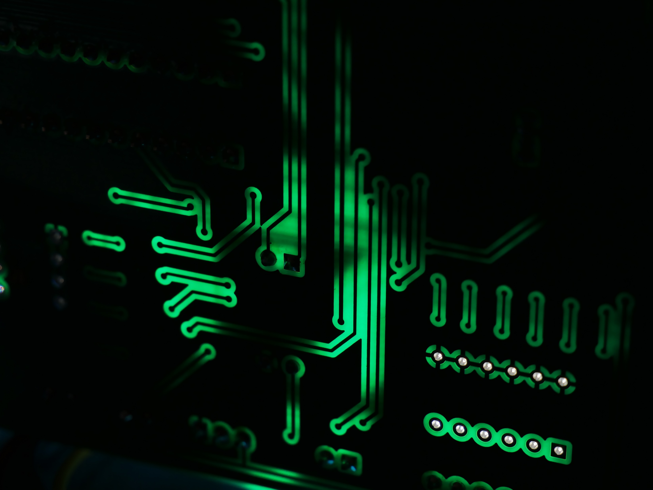
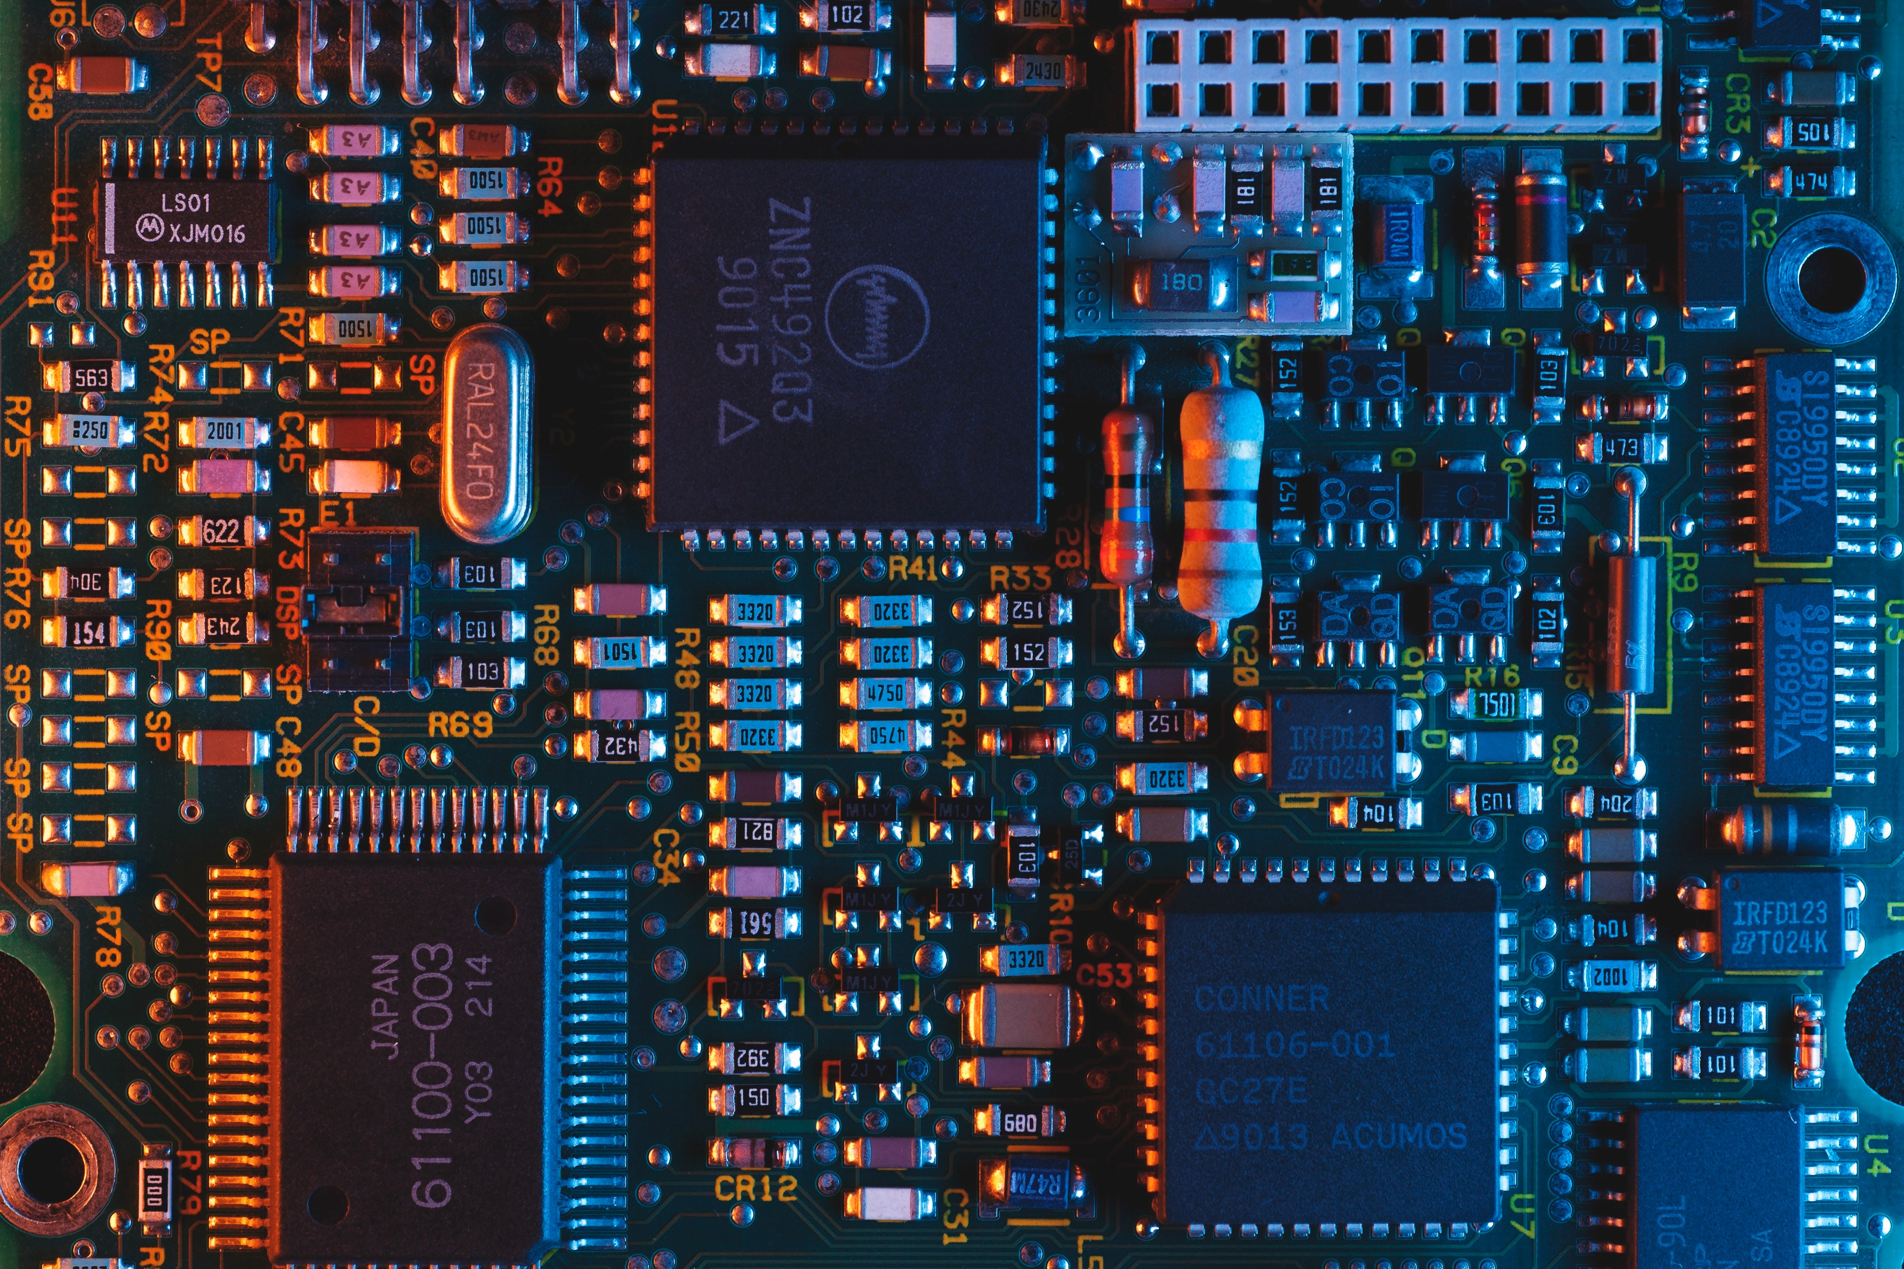
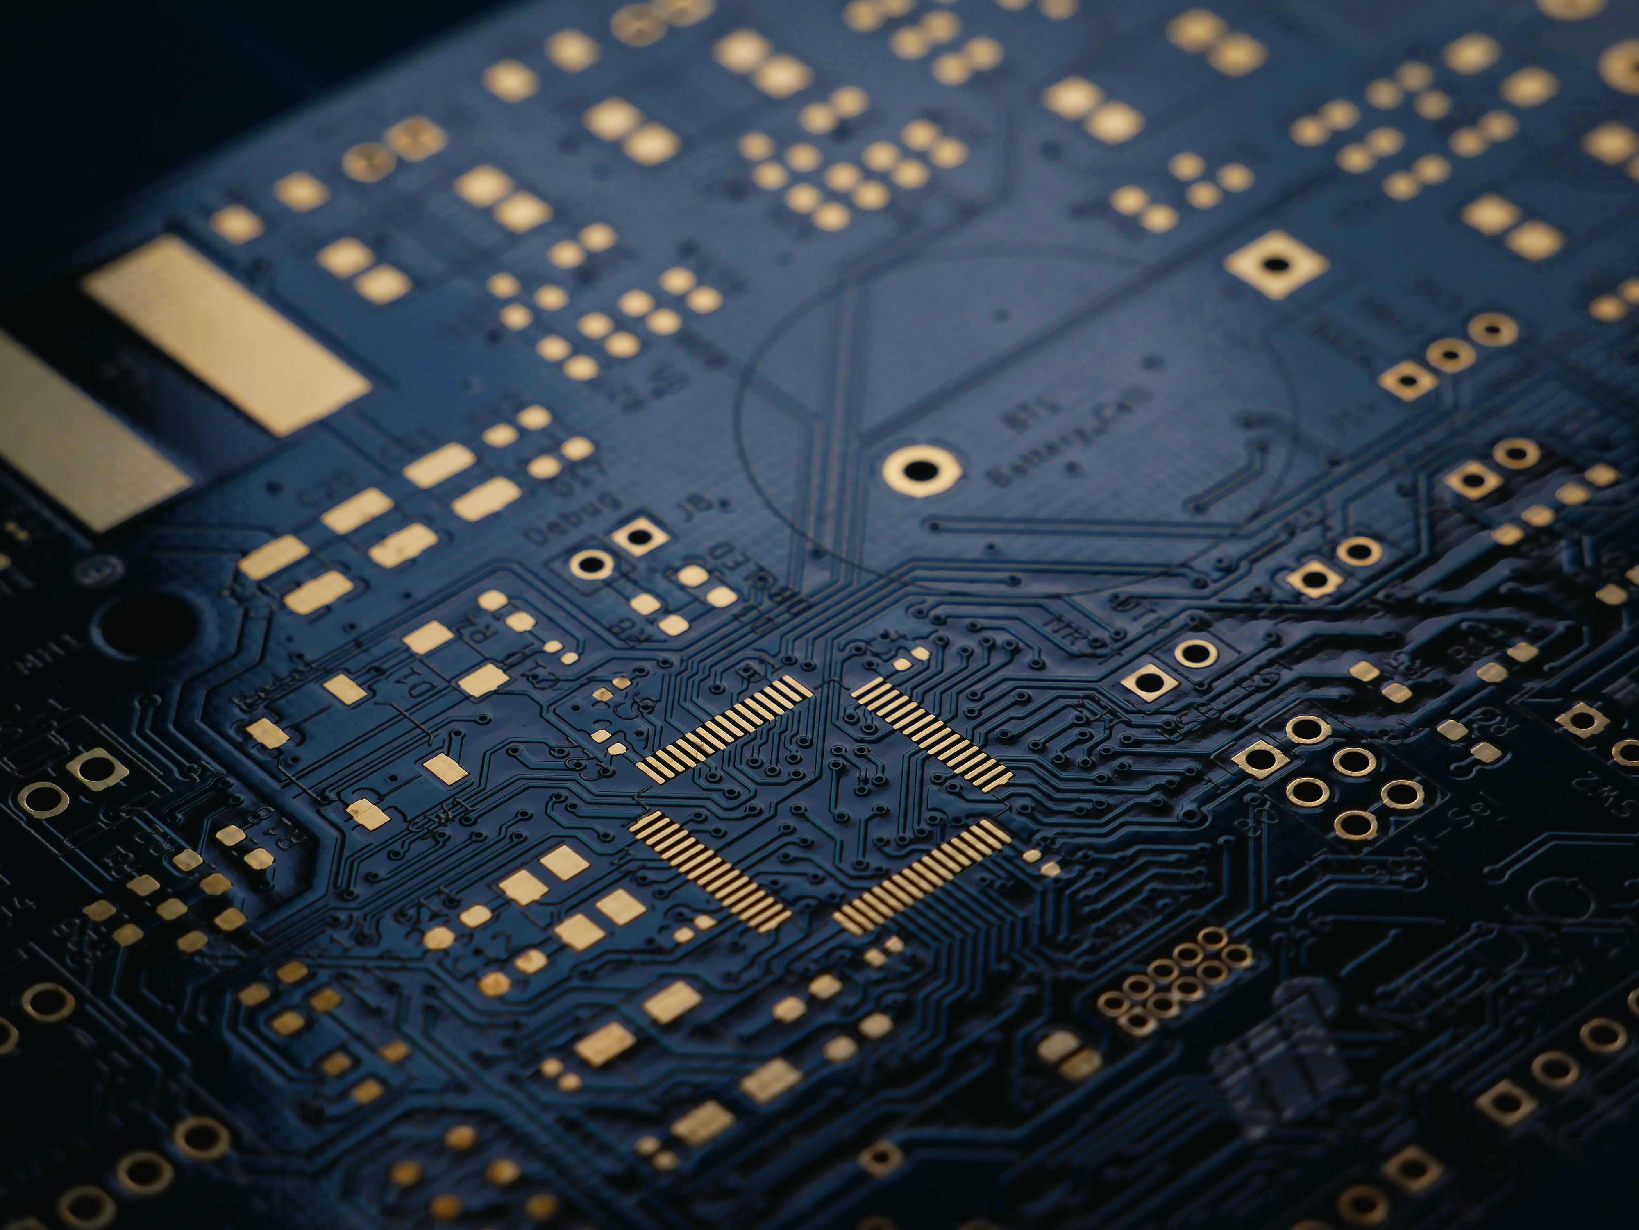
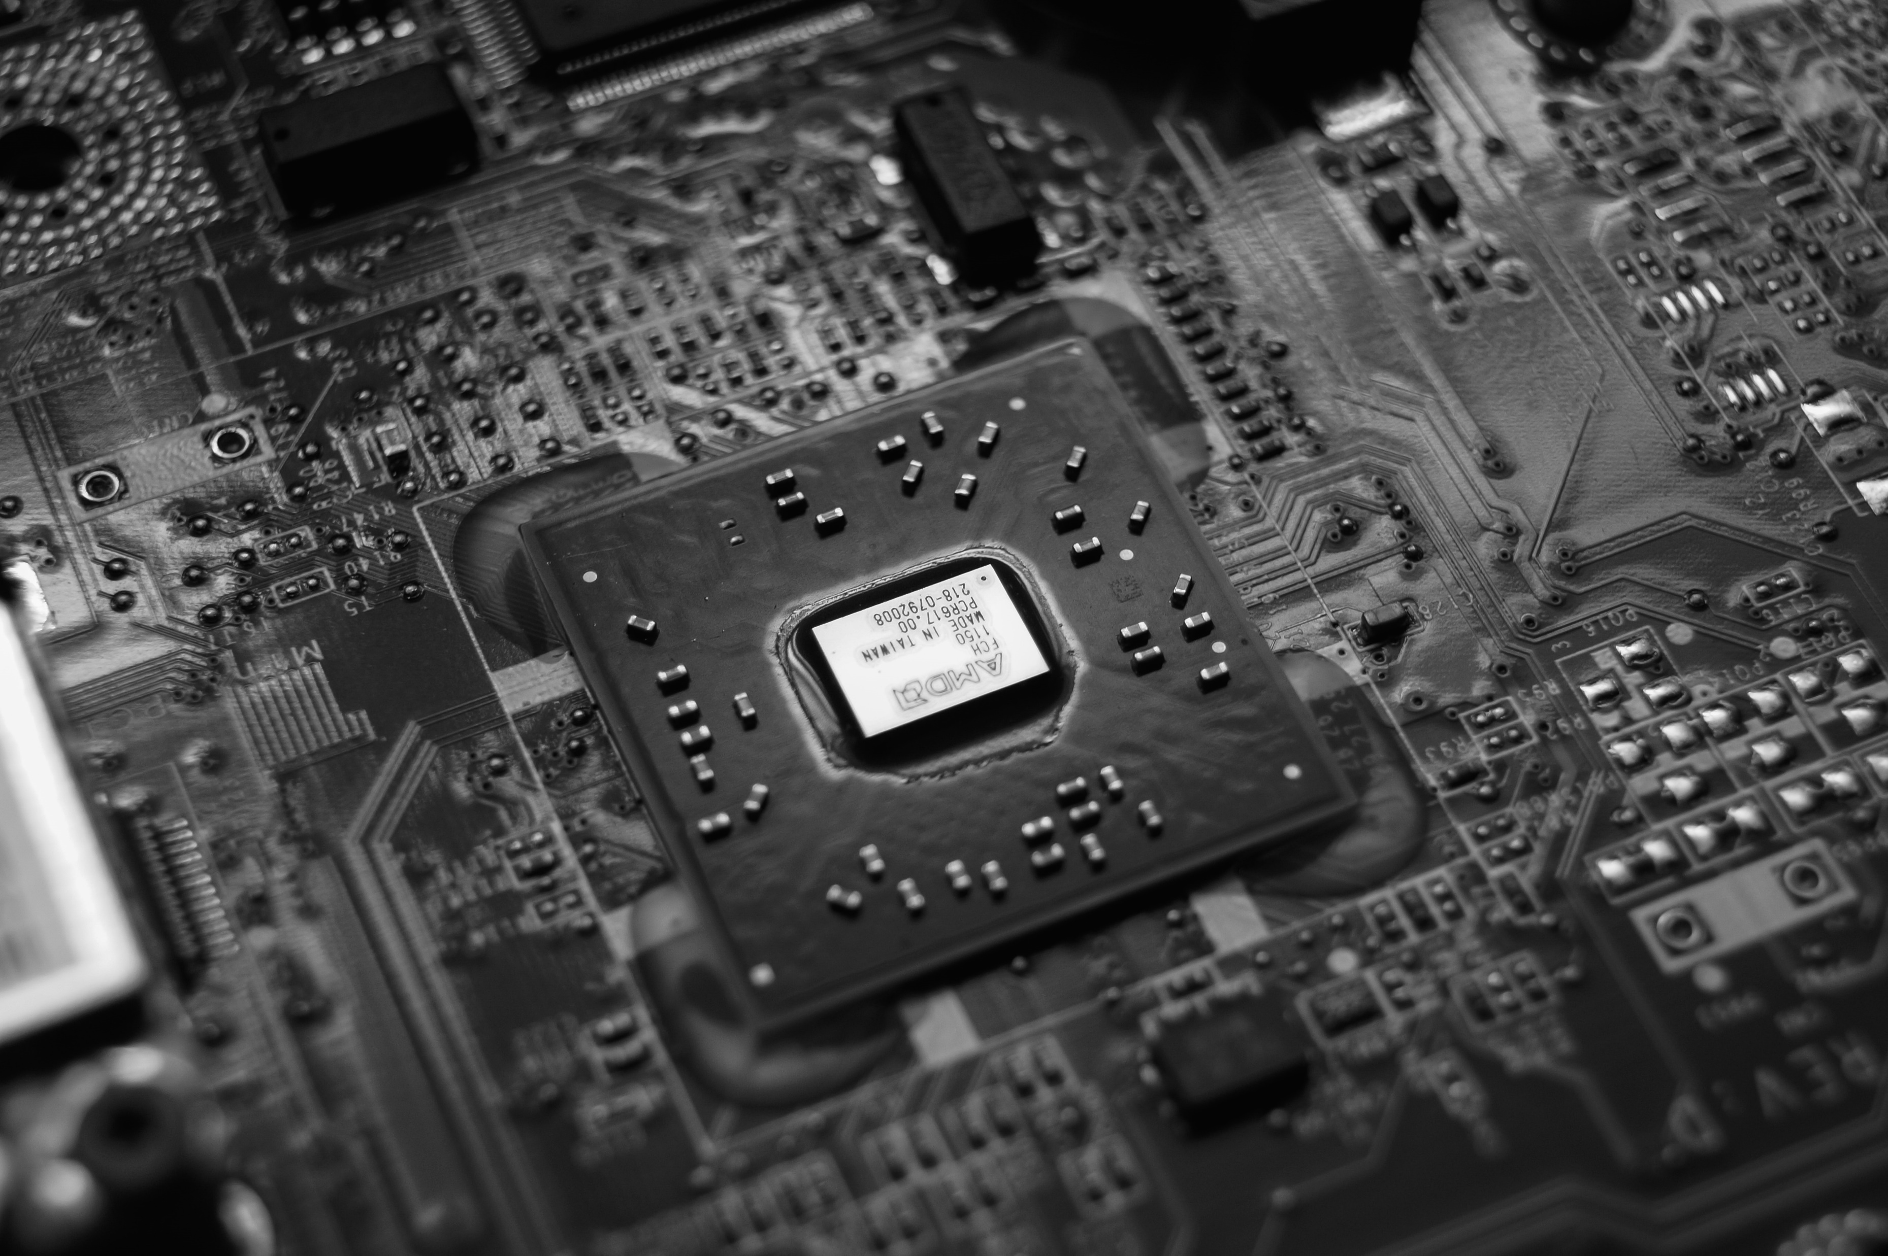
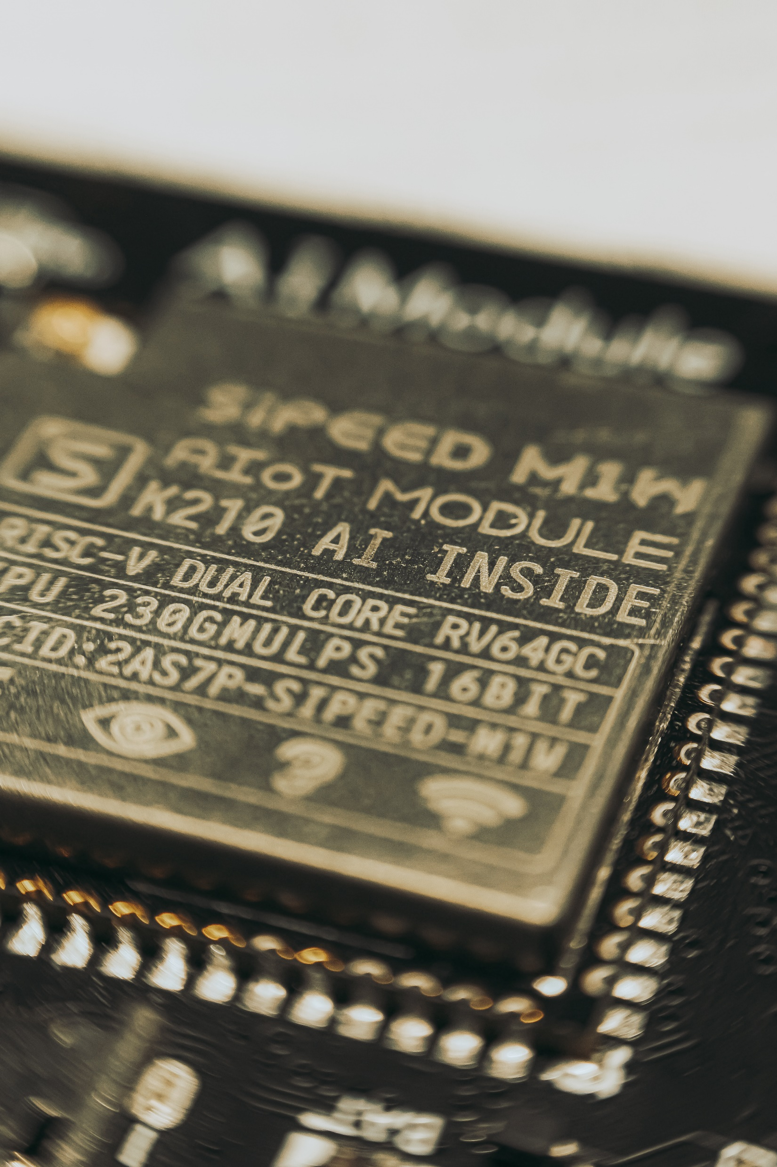
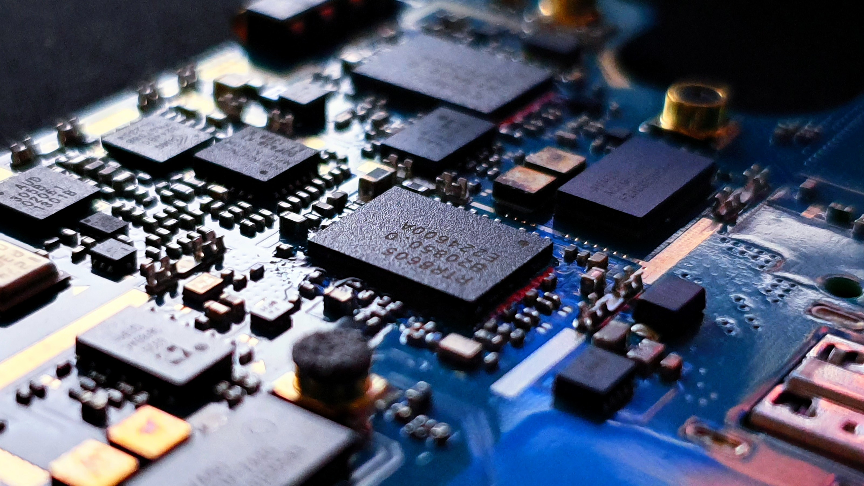
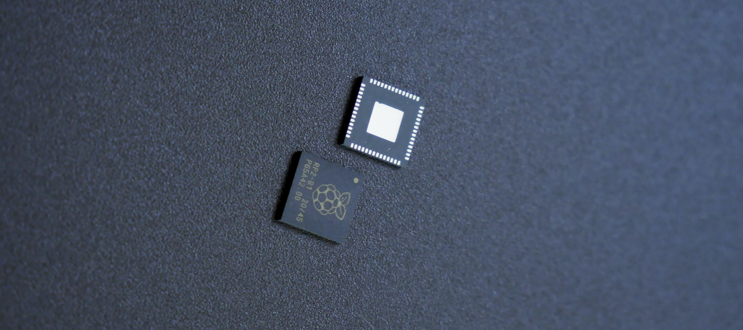
INTELLERA

Slide 4
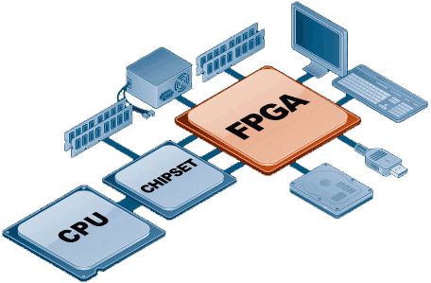



RECAP
INTELLERA
Problem Statement:
RISC-V Processor on FPGA
Power-Efficient Hardware Design
Matrix MAC Operations
Significance:
Innovation
High-Performance Computing
Benefits:
Speed
Efficiency
Breakthroughs

Slide 5
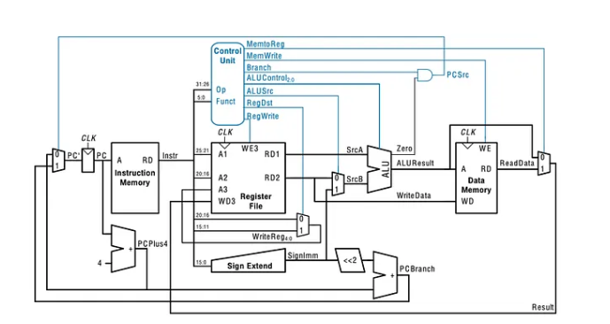
Single Cycle Processor
Sep 2023 – Oct 2023
Features:
Full Functional Control unit
Able to Execute 18 different Instructions
Analysis:
18 LUTs
200 FF
200 MHz Freq
INTELLERA

Slide 6
5 Stage Pipelined Processor
Sep 2023 – Oct 2023
Features:
Full Functional Control unit
Able to Execute 18 different Instructions
Analysis:
18 LUTs
200 FF
200 MHz Freq
INTELLERA

Slide 7
5 Stage Pipelined Processor
With Control Unit
Sep 2023 – Oct 2023
Features:
Full Functional Control unit
Able to Execute 18 different Instructions
Analysis:
18 LUTs
200 FF
200 MHz Freq
INTELLERA

Slide 8
5 Stage Pipelined Processor
With Matrix MAC
Sep 2023 – Oct 2023
Features:
Full Functional Control unit
Able to Execute 18 different Instructions
Analysis:
18 LUTs
200 FF
200 MHz Freq
INTELLERA

Slide 9

Feature Matrix
Sep 2023 – Oct 2023
Features:
Full Functional Control unit
Able to Execute 18 different Instructions
Analysis:
18 LUTs
200 FF
200 MHz Freq
INTELLERA

Slide 10
Analysis
Sep 2023 – Oct 2023
Features:
Full Functional Control unit
Able to Execute 18 different Instructions
Analysis:
18 LUTs
200 FF
200 MHz Freq
INTELLERA

Slide 11

Demonstration
Sep 2023 – Oct 2023
INTELLERA

